Slide 1
Module 6. Network Forensics
(part 3)

Slide 2
Topics
Networking Fundamentals
Types of Networks
Network Security Tools
Network Attacks
Incident Response
Network Evidence & Investigation

Slide 3
Networking Fundamentals

Slide 4
Network Concepts
TCP/IP (Transmission Control Protocol / Internet Protocol)
  The common language for the Internet
Client/Server Network
  Each computer has one of the roles: client or server
  Modern computers mix the roles
Peer-to-peer Network
  Every member has same role, as both client and server
  Commonly used with bittorrent to share files illegally

Slide 5
Network Types
LAN (Local Area Network)
  Within a single building or a few nearby buildings
WAN (Wide Area Network)
  Larger area
Internet
  Largest WAN, the whole world
MAN (Metropolitan Area Network)
PAN (Personal Area Network)
  Bluetooth: max. range 10 meters
CAN (Campus Area Network)

Slide 6
IP Addresses
IPv4: 32 bits, in four octets
  Each octet written as a decimal number 0-255
  Ex: 192.168.1.101
  Only four billion total addresses
  They are running out
IPv6: 128 bit in eight 16-bit fields
  Each field a 4-character hexadecimal valoe
  Range 0000 – FFFF
  Ex: 2001:0db8:0000:0000:1111:2222:3333:4444
  Many addresses: 300 billion billion billon billion

Slide 7
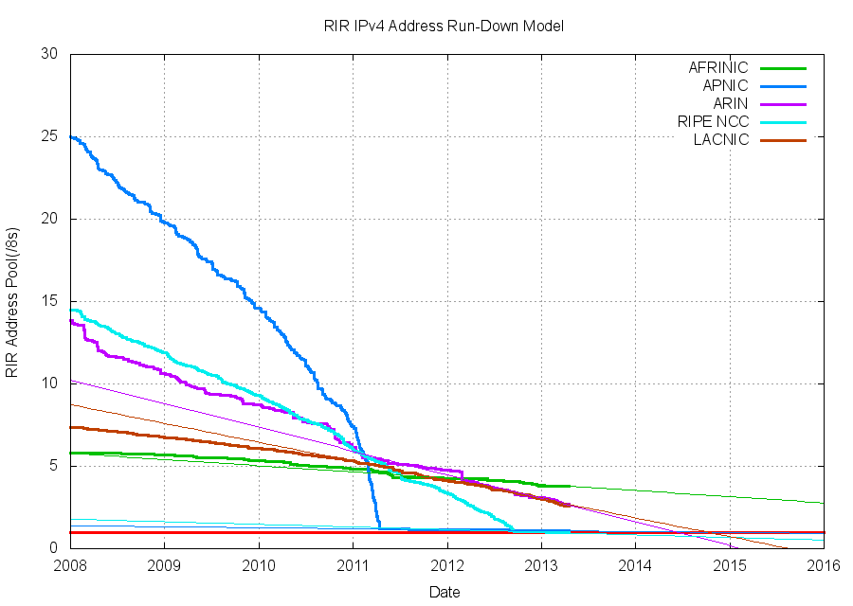

Slide 8
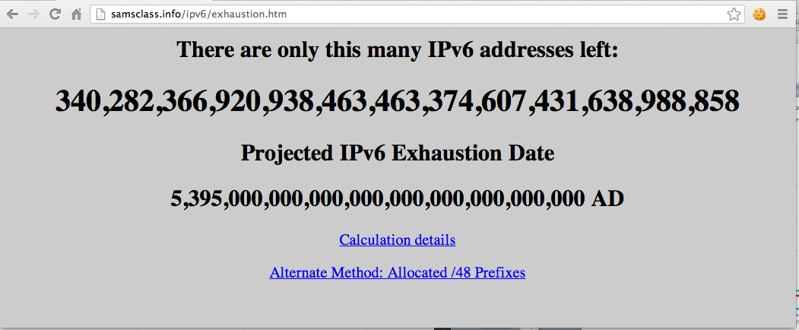

Slide 9
Network Security Tools

Slide 10
Firewalls, IDS, and Sniffers
Filters inbound and, optionally, outbound traffic
Simple firewalls filter based on packet headers
  IP address, port nnumber
Layer 7 firewall
  Looks inside packet to discriminate more
  Can detect Facebook, TeamViewer, BitTorrent
Intrusion Detection System
  Blocks malicious traffic based on a set of definitions
  Ex: Snort
Sniffer
  Captures packets for analysis
  Ex: Wireshark

Slide 11
Network Attacks

Slide 12
Network Attacks
DDoS (Distributed Denial of Service)
  Many bots attack a server
IP Spoofing
  False Source IP in packets
  Can make attacks appear to come from trusted sources
Man-in-the-Middle
  Intercept traffic
  Attacker can examine or alter data
  Can impersonate user
  Defense is SSL

Slide 13
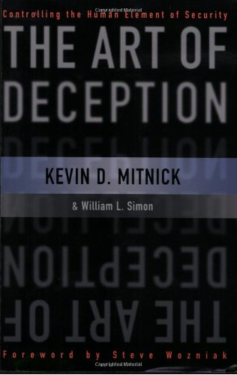
Social Engineering
Tricking people into security violations

Slide 14
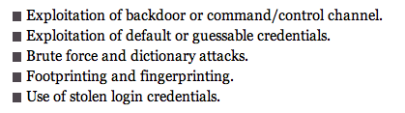
Most Common Hacking Methods
Backdoor
  From a malware infection allowing remote control
Footprinting
  Gathering public information about a target
Fingerprinting
  Scanning a target for open ports and other information
Based on a 2011 Verizon study

Slide 15
Insider Threat
The biggest threat
Does more harm than external attacks
Difficult to detect or prevent

Slide 16
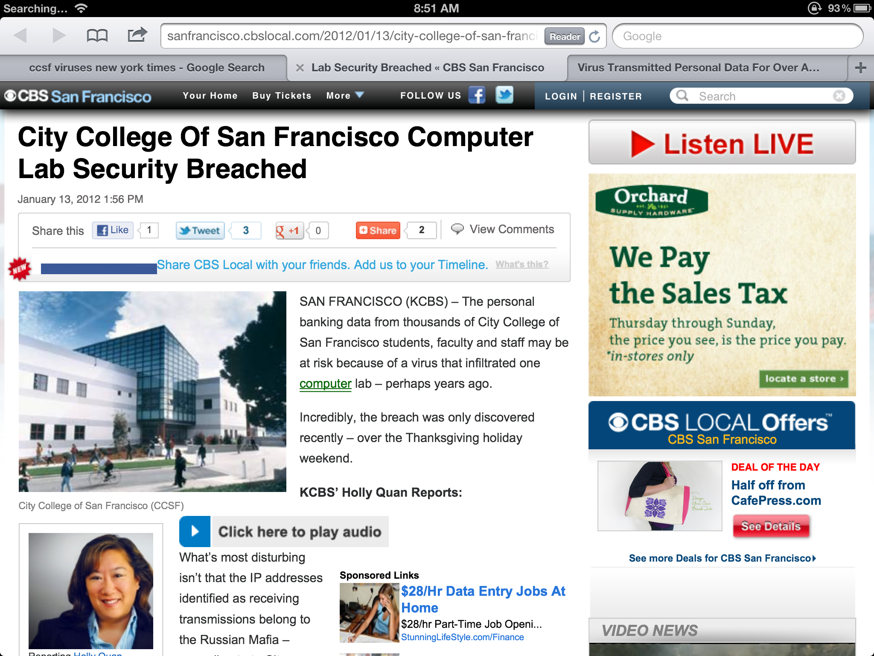

Slide 17



Slide 18
Incident Response

Slide 19
NIST Process
Preparation
  Planning for security incidents
  Proactive defenses, such as
    Hardening systems
    Patching
    Perimeter defense
    User awareness training
    Policies, procedures, and guidelines
Detection and Analysis
  IDS produce false positives
  Network traffic is erratic

Slide 20
NIST Process
Containment
Eradication
Recovery
Postincident Review
  Root-cause analysis
  Plan how to prevent future incidence
  Revise policies and procedures

Slide 21
Network Evidence & Investigation

Slide 22
Where is the Evidence?
All devices along the route may contain log files
  Servers
  Routers
  Firewalls
  Evidence may be volatile

Slide 23
Log Files
Authentication log
  Account and IP address of users
Application log
  Timestamps shown when application was used and by whom
Operating system log
  Track reboots, file access, clients served, and much more
Device logs
  On routers and firewalls

Slide 24
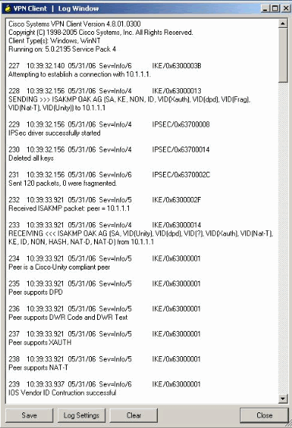

Slide 25
Network Investigative Tools
Wireshark
  Sniffer
NetIntercept
  Hardware applicance to record network traffic
NetWitness Investigator
  Can gather and analyze network traffic
Snort
  IDS

Slide 26
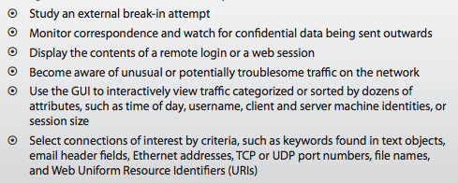
NetIntercept

Slide 27
Network Investigation Challenges
IP addresses can be spoofed
  Bounced through proxies
  Or through compromised systems
  Or through the Tor anonymity network
Logs are often incomplete or absent
  Logs are erased after some time
  Attackers can erase logs
Jurisdiction
  Attacks can cross state or national boundaries

Slide 28
Q&A
http://fpt.edu.vn

